Slide 1


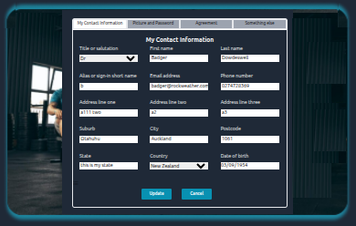




width = 390 pixels
height = 248 pixels

